Slide 1


Dr. Martina Rosenmayr-Khoshideh

Slide 2
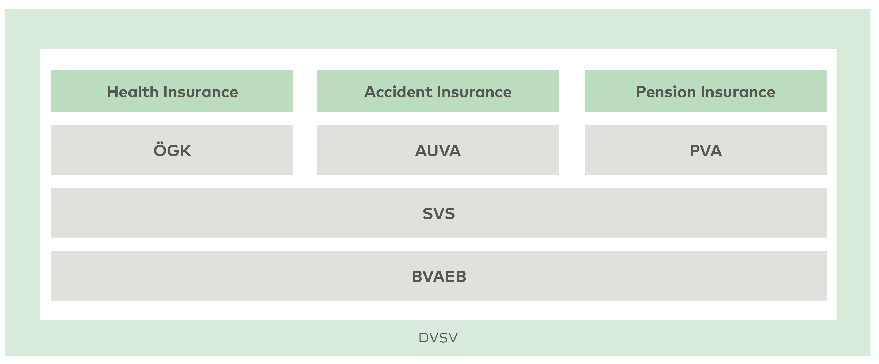
Organization of Austrian Social Security

Slide 3
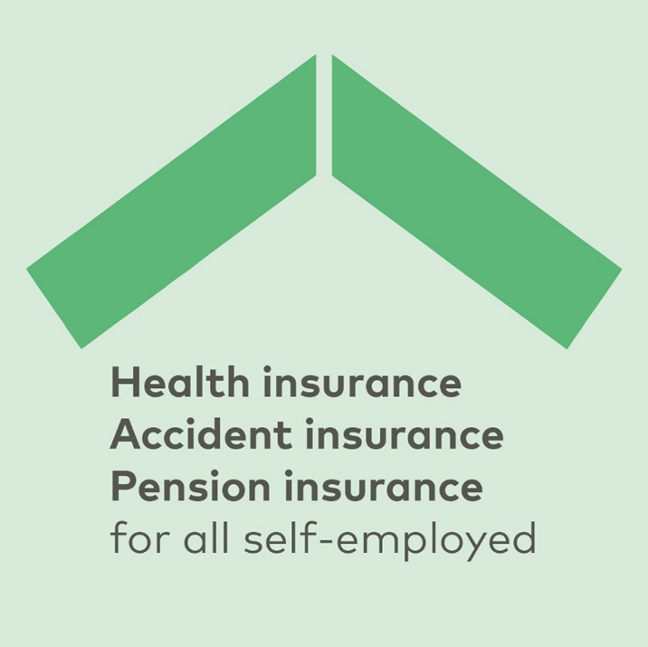


Social Security for the Self-Employed
One-stop provider for all social security matters for self-employed persons everywhere in Austria
Benefits of around 13.2 billion € annually for 1.3 million insured persons
(including co-insured dependents)
Organized as self-governing body

Slide 4
„
„
The gradual introduction of health, accident, and pension insurance for self-employed persons can be regarded as one of the major achievements of the Austrian social welfare system in the 20th century. … Mandatory social security did not remain a privilege of employees.
Mag. Magdalena Irnstötter, MA (SVS) and Dr. Christina Schnittler (University of Vienna)

Slide 5




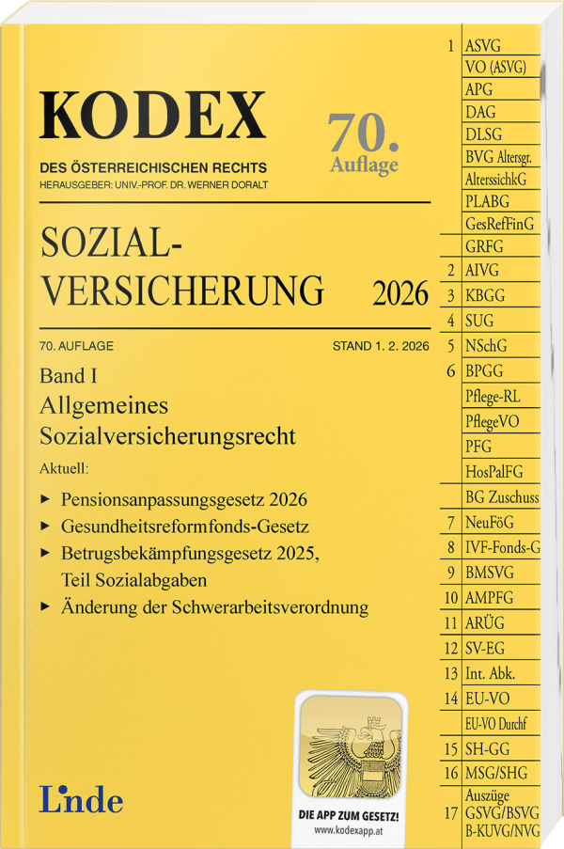
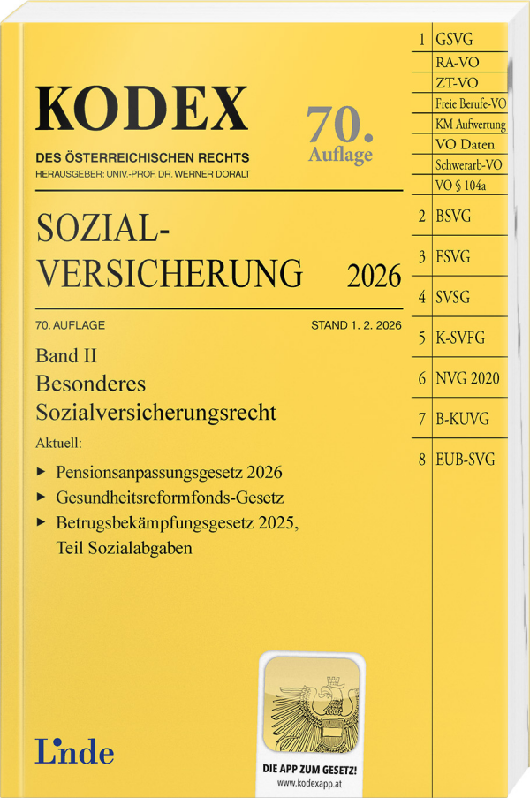

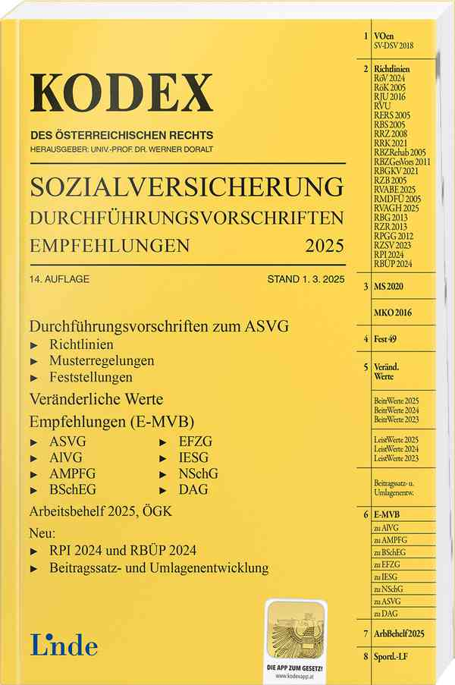




Self-Employed Persons – special social insurance systems
Trade professional (member of the Chamber of Commerce)
99.9 % of Austrian
population is covered
by mandatory health
insurance
Farmers (agriculture and forestry)
New self-employed persons
Compulsory social insurance is complemented by voluntary options
Liberal professions (Members of a Chamber of liberal professions
or independent protection schemes)

Slide 6
„
„
A single institution acting as a multi-branch provider for all self-employed persons exists in this form only in Austria.
Univ.-Prof. Mag. Dr. Elisabeth Brameshuber (University of Vienna) on the advantages of
Austria’s social insurance system for the self-employed

Slide 7
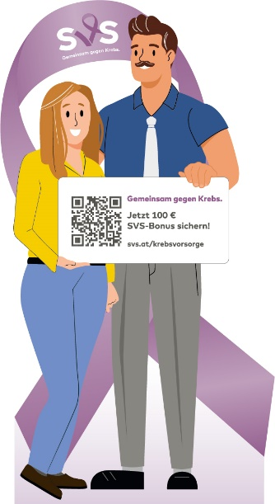

Exercise
SVS Focus on Prevention – Personal Responsibility & Nudging
Nutrition
Fit for Self-Employment
Junior
Health Check
Mental Health
100 Euro for Safety
100 Euro for Health
Webinars/ Lectures
Camps
Health Weeks
Holiday Camps
Activities in Setting
Rehab
individually
2-3 Hours
3-4 Days
10-15 Days
15 Days
individually
3-4 Weeks
“Vaccinated Healthier”
“Prevention Together”
“Smile Together”
“Together against Cancer”

Slide 8
„
„
It is always important to compare the organization, to benchmark, and to look beyond borders: What are other countries doing, what can we improve, and which ideas can we adopt?
Peter Lehner (Chairman SVS) on the importance of international comparison for the SVS

Slide 9





SVS Research Activities
SVS-Gipfelgespräche
(summit – national conferences)
Research cooperation
with the University of Vienna
Social Protection
Mandatory by law the SVS also engages in research on social protection for the self-employed
Examination of the EU Council Recommendation
on access to social protection for the self-employed
SVS Research
Activities

Slide 10




EU Recommendation on Access to Social Protection
The Recommendation outlines four key dimensions for improving access to social protection:
Formal Coverage
Effective Coverage
Adequacy
Transparency
Opportunity to accrue benefits and the ability, in the event the corresponding risk materializes, to access a given level of benefits
Benefits should be sufficient and timely; Contributions should be proportionate to the contributary capacity
Legal entitlement to participate in social protection schemes
Clear, accessible information and simplified administration

Slide 11







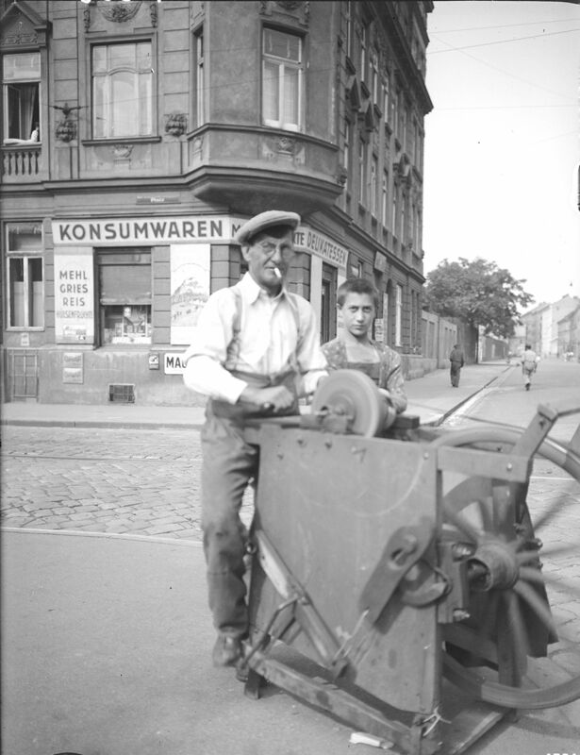
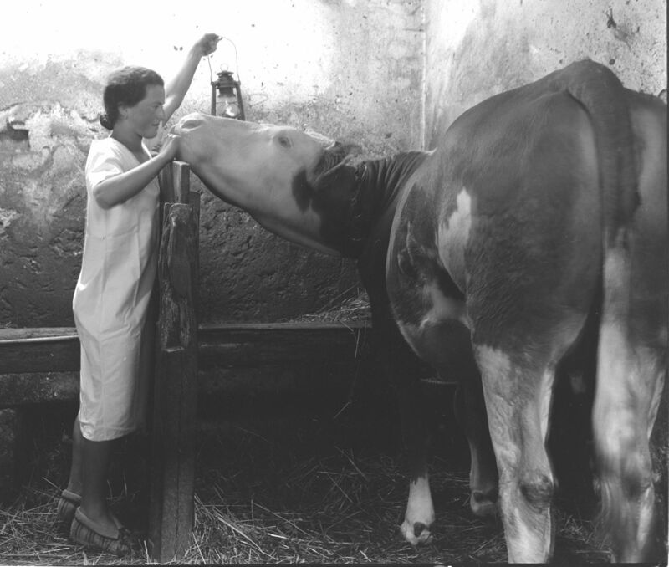
Austria’s Implementation of the EU Recommendation
Austria, through the SVS, fulfils the Council Recommendation on Access to Social Protection
All major branches of social protection are covered for self-employed persons:
No significant formal coverage gaps have been identified
SVS offers a comprehensive, preventive, and digital approach to social protection
Health
Accident
pension
maternity/paternity
invalidity
survivors’ benefits unemployment insurance available via opt-in mechanisms

Slide 12
Social Protection in Light Council Recommendation on Access to Social Protection
Branches of Social Protection | Social Protection of Self-Employed Persons | Formal Coverage*
Sickness and healthcare benefits | Comprehensive Mandatory Insurance Where applicable, voluntary insurance options are available Farm relief services as voluntary benefits | ✓⁽~⁾
Maternity and equivalent paternity benefits | Maternity benefits are provided through health insurance | ✓
Benefits in respect of accidents at work and occupational diseases. | Comprehensive Mandatory Insurance Where applicable, voluntary insurance options are available | ✓
Invalidity benefits | Benefits provided under the pension insurance scheme | ✓
Old-age benefits and survivors’ benefits | Comprehensive Mandatory Insurance Voluntary insurance options are available | ✓
Unemployment benefits | “Opting-In” Option for trade professionals and the New self-employed No voluntary option for farmers Extension of framework deadlines can apply | ✓~
* Adapted from the presentation by Julia Höllwarth. LL.M. (WU) University of Vienna on the Social Protection of the Self-Employed in Austria

Slide 13
„
„
Austria ranks among the top countries in terms of social protection for the self-employed and could serve as a model across the EU.
Laurent Aujean (European Commission)

Slide 14
Transparency
Member States are recommended to ensure that the conditions and rules for all social protection schemes are transparent and that individuals have access to updated, comprehensive, accessible, user-friendly and clearly understandable information about their individual entitlements and obligations free of charge.
15.
Member States are recommended to simplify, where necessary, the administrative requirements of social protection schemes for workers, the self-employed and employers, in particular micro-, small and medium-sized enterprises.
16.

Slide 15



Safety Net
Providing a robust safety net that ensures strong protection.
Extensive Coverage
The combination of mandatory and voluntary insurance options means that self-employed individuals benefit from extensive coverage, which adresses health, accident and pension needs.
SUMMARY
Leader
Far beyond the minimum standards, setting Austria apart as a leader in social protection for the self-employed.
Strong System
The Council´s guidance ensures that the system remains strong, transparent, and supportive.

Slide 16
Thanks for your attention

