Slide 1
EU Framework on
Access to Social Protection for self-employed
Conference on Protecting the self-employed: social security across Austria and Europe
3rd March 2026
Dana-Carmen Bachmann
Head of Unit, Social Protection and Demography, European Commission

Slide 2
2019 Council Rec°. on access to social protection for workers and the self-employed
  Objective to provide similar coverage as employees recognised in the European Pillar of Social Rights (2017) – principle n°12
  2019 Council Recommendation aims to ensure inclusive access to social protection for all workers and self-employed individuals.
  Implementation supported at EU level via:
    Monitoring and evaluation
    Mutual Learning and knowledge sharing
    European Semester (and Technical support Instrument)
    Recovery & Resilience Plans (reforms and investments)
Notes:
EPSR ppl 12: Regardless of the type and duration of their employment relationship, workers, and, under comparable conditions, the self-employed, have the right to adequate social protection.

Slide 3
Scope/Branches:
Unemployment benefits
Sickness and healthcare benefits
Maternity and paternity benefits
Invalidity benefits
Old-age and survivor benefits
Benefits in respect of accidents at work and occupational diseases
For:
all workers &
the self-employed
Council Recommendation
on Access
to Social Protection
(adopted in
November 2019)
4 dimensions:
Formal Coverage
Workers:
- mandatory basis
- all branches
Effective coverage
Entitlements and contributions:
- rules that do not prevent access
Entitlements:
- preserved, accumulated and/ or transferable
Adequacy
Benefits:
- sufficient and timely
Contributions:
- proportionate
Exemptions, reductions:
- regardless of status
Self-employed:
- min. voluntary basis
Transparency
Schemes’ rules:
- transparent
- administrative simplification (esp. SMEs)
General and indiv. information:
- up-to-date, clear, free
Notes:
improving the formal coverage and extending it to:
(a)
all workers, regardless of the type of employment relationship, on a mandatory basis;
(b)
the self-employed, at least on a voluntary basis and where appropriate on a mandatory basis.
Member States are recommended to ensure that the calculation of the social protection contributions and entitlements of the self-employed are based on an objective and transparent assessment of their income base, taking account of their income fluctuations, and reflect their actual earnings.

Slide 4
Monitoring the implementation of the Recommendation
Recommendation adopted by the Council in November 2019
…to implement principle 12 of the European Pillar of Social Rights
Member States:
implement the principles set out in this Recommendation as soon as possible and [to] submit a plan by 15 May 2021
Social Protection Committee adopted version 0 of Monitoring Framework (updated three times)
Commission reviewed the implementation of the Council Recommendation and adopted a Report to the Council in January 2023
Monitoring Framework with Social Protection Committee

Slide 5
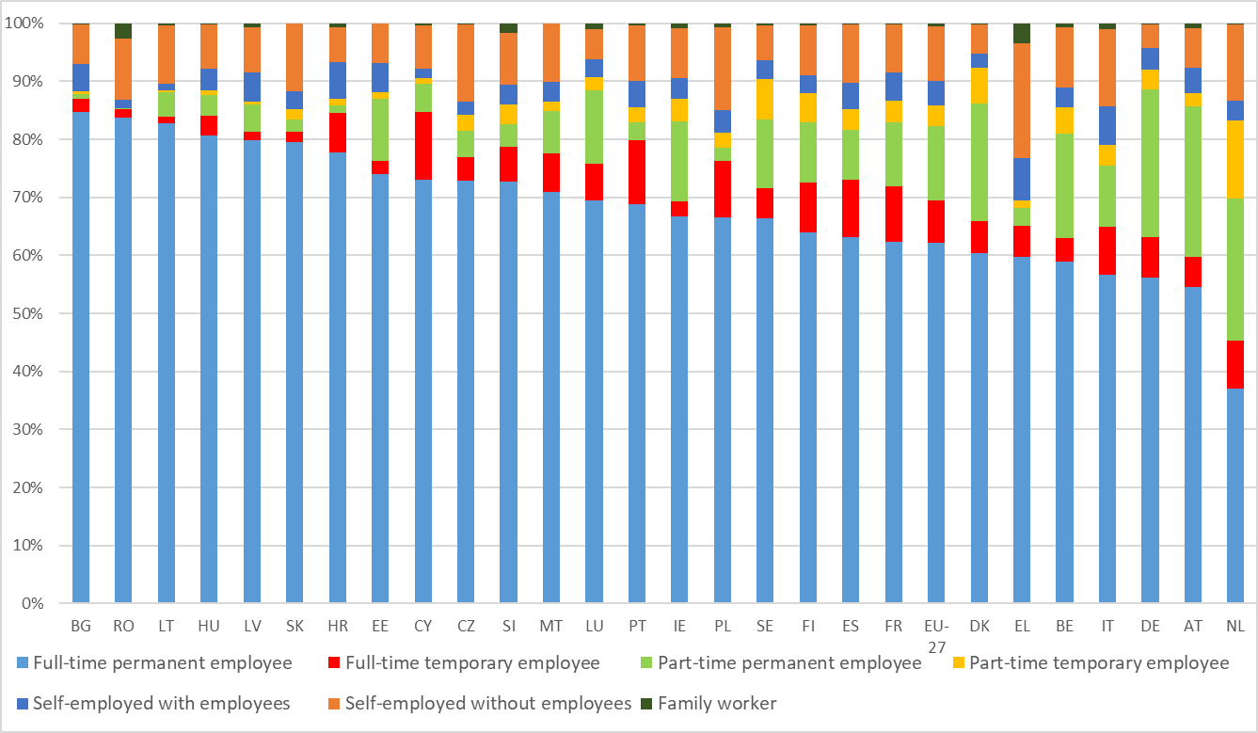
Labour market statuses by Member State (aged 15-74), 2024
At EU-27 level

Slide 6
Economically dependent solo self-employed in the EU-27 (aged 15-74, in 2024)
19.1 million solo self-employed
(= 2/3 of the self-employed
and 9.4% of tot. pop in employment)
Among which:
765,000 for which the dominant client decides working hours
(i.e. 0.4% of tot. pop in employment)
Among which: 3.3 million with only one client, or a dominant one
Source : EU-LFS (2024)

Slide 7
Specific challenges for self-employed
Formal coverage (as of mid-2025):
19 Member States have formal coverage gaps for at least one group of self-employed in one branch of social protection or more
  Branches most concerned by ‘lack of access’ are: unemployment benefits (14), followed by benefits in respect of accidents at work and occupational diseases (9)
  Voluntary coverage for the self-employed is accessible in 15 Member States mostly through opt-in systems. The most common branches with voluntary access to social security schemes are: sickness benefits (11), maternity benefits (9) and benefits in respect of accidents at work and occupational diseases (7).
Adequacy and effective coverage
Least likely group to receive (individual-type) benefits when at risk of poverty before social transfers (11.5% of the self-employed received some social benefits in 2024, vs 30.4% rate among all types of employees)
20.9% of self-employed at risk of poverty vs 6.3% rate for all types of employees – though challenging to accurately measure the income of the self-employed,
Considerable variation in material and social deprivation rates: in more than ½ of the Member States, these rates are below 5% - but higher deprivation levels in some, reaching up to 23.6% in EL and 34.8% in RO

Slide 8
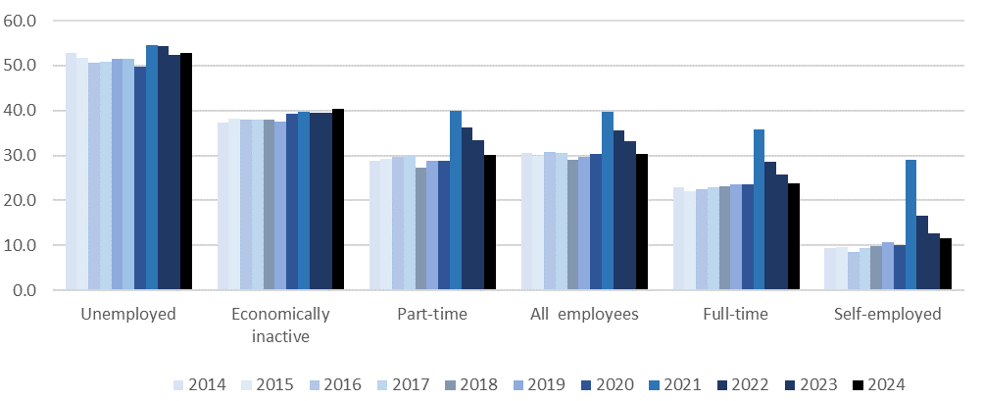
A lower coverage rate by social benefits compared to other categories…
Share of working-age population receiving any benefit among people (16-64) at-risk-of-poverty before social transfers, by most frequent activity status in income reference year, EU-27, 2014-2024 (%)
Notes:
The self-employed in the EU are the least likely group to receive individual-type benefits when at risk of poverty before social transfers. In 2024, only 11.5% of the self-employed received some social benefits, which is significantly lower than the 30.4% rate among all types of employees. This percentage for the self-employed has declined from a peak of 29.0% in 2021

Slide 9
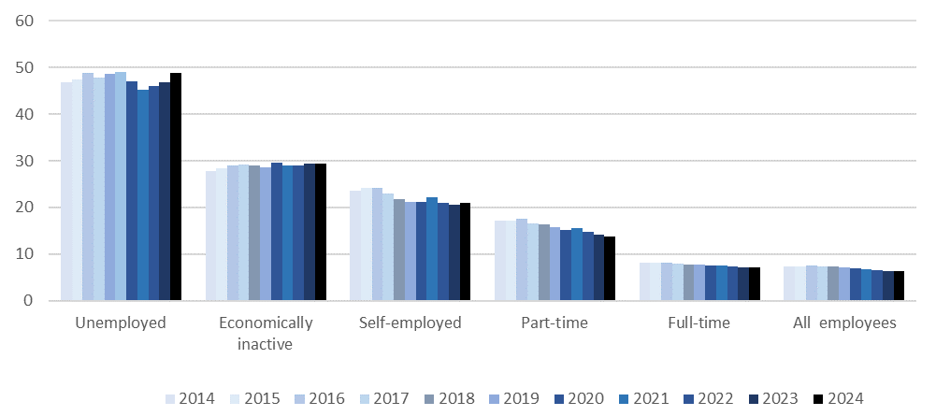
A high poverty rate compared to other categories…though the measurement is not entirely comparable (i.e. definition of income..)
At-risk-of-poverty rate after social transfers, by most frequent activity status in income reference year (16-64), EU-27, 2014-2024 (%)
Notes:
In 2024, the self-employed face a 20.9% risk of poverty, which is significantly higher than the 6.3% rate for all types of employees, resulting in a gap of 13.6 percentage points. However, due to challenges in accurately assessing the income of the self-employed, EU-wide AROP rate analyses and comparisons across Member States should be treated cautiously

Slide 10
Support by the Commission via mutual learning
February 2024: mutual learning on access to healthcare, sickness benefits and accidents at work
February 2025: mutual learning on access to social protection for vulnerable workers (including solo self-employed)
May 2025: mutual learning on access to social protection for artists and professional from cutural sector
28-29 April 2026 (forthcoming) : mutual learning on Coverage and contributions for the self-employed
Notes:
Member States are recommended to ensure that the calculation of the social protection contributions and entitlements of the self-employed are based on an objective and transparent assessment of their income base, taking account of their income fluctuations, and reflect their actual earnings.

Slide 11
Recent reforms extending coverage (1/2)
Spain
Contribution system reform (2022) under Recovery and Resilience Plan → Contributions now linked to real income, improving fairness and pension adequacy
Improved protection for cessation of activity (2023) → New benefit for self-employed in sectors affected by temporary downturns
Italy
ISCRO scheme made permanent (Income Support for Freelancers) → Provides income protection for freelance professionals facing significant income drops → Transition from temporary COVID measure to structural protection
Finland
YEL pension reform (2023) → Mandatory 3-year reviews of declared pensionable income
→ Adjusted wage coefficient to better reflect comparable earnings
Planned joint unemployment insurance (2026) → Coverage for individuals combining self-employment and salaried work
The Netherlands
Transition from temporary COVID support (TOZO) → Self-employed integrated into more permanent income support system (Bbz)
Ongoing preparation of mandatory basic disability insurance for self-employed

Slide 12
Recent reforms extending coverage (2/2)
Belgium
  Platform Workers: Presumption of employment for platform workers since January 2023.Mandatory insurance against workplace accidents from January 2026.
Cyprus
  Coverage extended to all self-employed for work accident, occupational disease, and parental leave benefits as of 2025
Denmark
  Maternity Benefit Rules: Transferable maternity benefits up to 22 weeks for self-employed. Work allowance of 3.5 hours per week without benefit reduction.
  Unemployment Insurance Reform: New rules for calculating benefits for bankrupt self-employed individuals
Germany
  Maternity Protection Adjustment Act: Extended coverage to non-standard workers and self-employed women with statutory health insurance from June 2025.

Slide 13
Directive on improving working conditions in platform work
Collective bargaining for solo self-employed
EU Guidelines (2022): competition law does not apply to the collective agreements of solo self-employed persons who are in a situation comparable to workers
the European Commission will also not enforce EU competition rules against collective agreements made by solo self-employed persons who are in a weak negotiating position, for example when there is an imbalance in bargaining power in negotiations with economically stronger companies or when they bargain collectively following national or EU legislation.
Coverage:
  all forms of collective negotiations about issues such as pay, working time and work patterns, OSH etc.
  solo self-employed persons, namely self-employed persons providing services primarily through their own personal labour.
Employment Status Clarification: criteria to distinguish between employees and self-employed for correct classification and associated rights.
Enhanced Social Protection: Aims to strengthen access to social security, including health, unemployment benefits, and pensions
Algorithmic Management Transparency: transparency and accountability in the use of automated systems and algorithms, ensuring fair treatment and decision-making.
Collective Rights: right to collective bargaining and representation
Notes:
On 14 October 2024, EU legislators adopted a new directive on platform work. The directive introduces the presumption of employment – to be applied following national rules – as well as the first EU rules to regulate algorithmic management in the workplace. The new rules will apply from 2 December 2026. Platform work is an umbrella concept covering a heterogeneous group of economic activities completed through a digital platform. Platform workers' rights are not enshrined in EU labour law and this is increasingly leading to problems relating to various aspects of their work and human development. To remedy this situation, the European Commission submitted a proposal for a directive aimed at improving the working conditions of platform workers, clarifying their employment status, and establishing the first EU rules for the use of artificial intelligence in the workplace.

Slide 14
Link to other EU initiatives
Job Quality roadmap and forthcoming Job quality Act
First ever EU Anti-poverty
strategy
Sectoral initiatives (Cultural Compass, Generation Renewal in Agriculture
(2027) Adequacy of Social Protection in old age (integrated Pensions adequacy and LTC analysis, covering also self-employed)

Slide 15

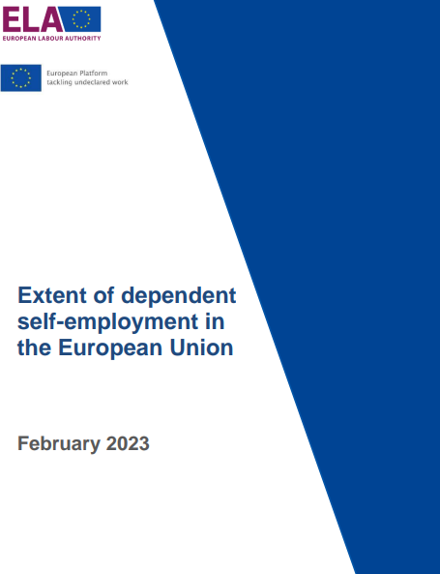
Other ressources regarding self-employed
Self-employment in the EU: Job quality and developments in social protection | Eurofound (2024)
Extent of dependent self-employment in the European Union (ELA, 2023)

Slide 16
Thank you

