Slide 1
Social security coverage for self-employed workers
Challenges and opportunities
SVS in Brussels
03 03 2026
Prof. dr. Paul Schoukens
KU Leuven – Tilburg University

Slide 2
Overview
Standard work and work-related social protection
Gaps in social protection for self-employed persons
Extending coverage
  Formal access
  Effective coverage
  Adequate protection and financing
Conclusion

Slide 3
  ‘Standard’ work and work-related social protection

Slide 4
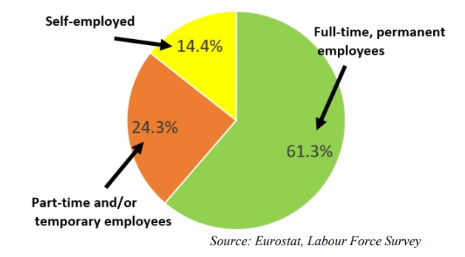
How does the labour market look?
Source: Eurostat, Labour Force Survey, 2018
Population in employment by status, EU-28, 2018
Population in employment by status, EU-27, 2021

Slide 5
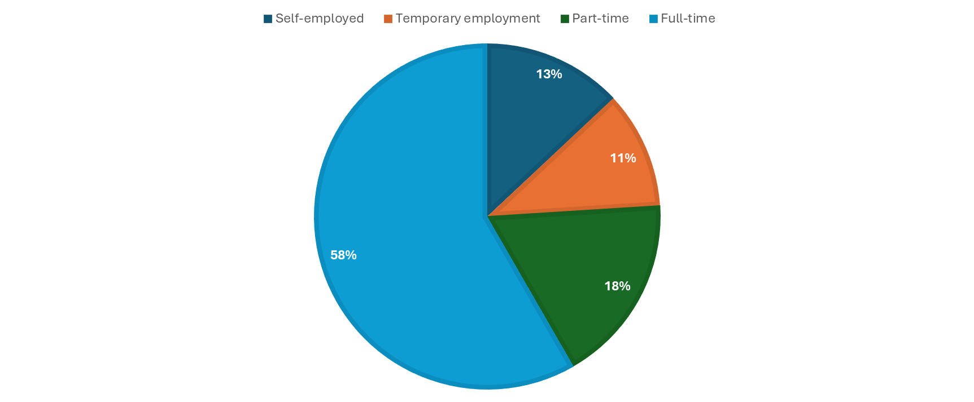
Labour market data 2024?

Slide 6
The meaning of standard work?
What is standard work?
Standard as ‘most common’
+/- 60% workforce in the EU is in indefinite full-time employment.
Standard as ‘regulatory standard’
“The stable, open-ended and direct employment relationship between a dependent, full-time employee and his unitary employer” (Walton, 2016)
became the standard for the regulation of the male labour market during Fordism because:
  It provided a secured pool of middle-skilled workers.
  It provided the income security needed for developing consumerism and the welfare State.

Slide 7
How non-standard work and self-employments challenge social protection?
Why is it important for
Social Protection?
How is it challenged by
self-employed?
Persons in ‘work’ earn a ‘salary’
Self-employed income = beyond salary …(reserves/ return on capital, …)
To define/
To detect
work
Persons not in work need to find work
Mediation to new SE activity?
Employer as key-actor for benefits / financing
Clients → Multiple ‘employers’?
SE declare themselves income
Irregular income patterns
Eer based social protection?
Issue of classification: Bogus self-employed
To detect employer
Employer decides on redundancy
Lack of labour / income stability
Thresholds in social protection schemes
Marginal work hours / low income
Difficult to track hours/income

Slide 8
Gaps in social protection for self-employed

Slide 9
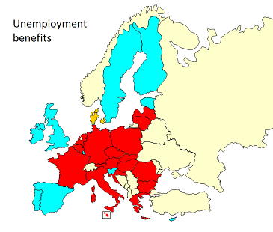
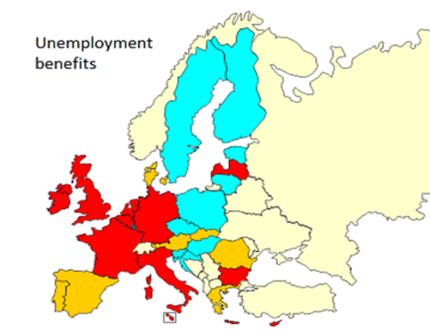
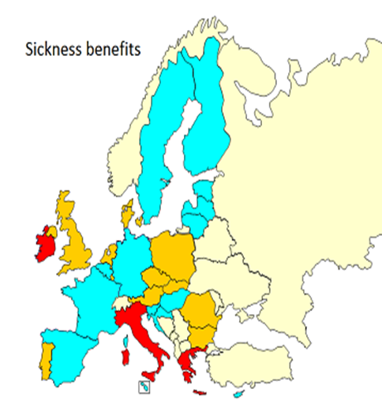
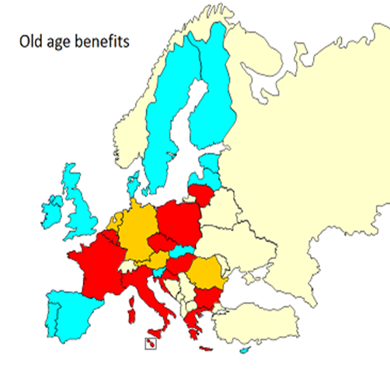


Is everyone having access to social protection?
The case of non-standard workers
The case of the self-employed

Slide 10
Access to social protection for self-employed workers
Most problematic schemes in terms of access: Unemployment – Accidents at work & occupational injuries - Sickness | Formal access
 | Available |  | Only means-tested/flat rate protection available (if different than for workers) | Not available
 | Mandatory | Voluntary / opt- out and exemptions
Unemployment | CZ, EL*, ES*, FR*, HR, HU, IE, LU, LT*, MT, PL, PT*, SI, UK* | AT, DE, DK, FI, RO, SE, SK | BE, EE | BG, CY, IT*, LV, NL
Accidents-at-work & occupational injury | AT, HR, HU, IT, PL, LU, MT, PT, SE, SI | DK, DE, ES, FI, UK |  | BE, BG, CY, CZ, EE, FR, EL*, IE, LV, LT, NL, RO, SK
Sickness benefits | AT*, BE, CY, DK, EL*, ES*, EE*, FI, FR, HR, HU, LU, LT, LV, MT, PL, PT*, RO, SE, SI, SK* UK* | BG, CZ, DE*, IE, NL |  | IT*
*access only for certain categories or differentiated access (voluntary/compulsory) according to the category of self-employed or income/asset/contribution levels.
Source: S. Spasova & S. Roshan (2023)

Slide 11
Gaps social protection (self-employed)
Regardless type of system
Own kind of work
  Unemployment
  Sickness
  Accidents at work/occupational diseases
Income thresholds (more recent evolution)
  Solo self-employed (free lancers)

Slide 12
Extending coverage

Slide 13
Principle 12 of the European Pillar of Social Rights
“Regardless of the type and duration of their employment relationship, workers, and, under comparable conditions, the self-employed, have the right to adequate social protection.”
‘Labour status neutrality’

Slide 14
Proposal for a COUNCIL RECOMMENDATION on access to social protection for workers and the self-employed - COM/2018/0132 final
Formal coverage
‘Member States are recommended to ensure access to adequate social protection for all workers and self-employed persons in respect of all branches mentioned in point 3.2. of this Recommendation. In light of national circumstances, it is recommended to achieve this objective by improving the formal coverage and extending it to:
  (a) all workers, regardless of the type of employment relationship, on a mandatory basis;
  (b) the self-employed, at least on a voluntary basis and where appropriate on a mandatory basis.’
(Council Recommendation 12753/19, 15 October 2019)

Slide 15
Extending formal coverage

Slide 16
Extending coverage: mandatory - voluntary
  Mandatory remains ‘standard’ approach
    Solidarity requires high degree of redistribution → statutory schemes (public law)
    Voluntary protection: high income groups and low income groups → drop out (Codagnone 2018)
    Low-take up SE overall voluntary schemes in reality
    Low take-up voluntary schemes → high potential dependency on social assistance schemes
    Risk of fragmentation protection according to (professional group)
      Mobility on flexible labour market?
      Growing relevance qualification professional activities (bogus self-employed)
  Voluntary: ‘non-standard’ approach

Slide 17
Extending coverage: effective protection

Slide 18
Problems effective coverage
Issue of waiting lists, minimum insurance periods, carenz days
Health care: rather exceptional (minimum qualifying period and especially minimum income thresholds)
Accidents at work/occupational diseases
  Sometimes waiting period
Sickness, invalidity and maternity: most countries
  Minimum qualifying period
  Waiting period (sickness)
    Sometimes covered by wage continuation
    Especially self-employed → shorter duration of payment benefit
Old age, invalidity and survivorship (pensions), including work accidents
  Qualifying records (and work records)
  Dual function: opening – composition of benefit
Unemployment
  Most schemes apply (min) work records (dual function)

Slide 19
Addressing effective coverage
Specific application rules justified by type of work (SE → sickness and unemployment)
  Reforms sickness/maternity schemes [Belgium, NL]
  Extending ánd adapting unemployment schemes in [IRE and DK]
  Own type of unemployment protection in NL (social assistance related) and B (bridging right)
  On basis of corona crisis: structural protection ‘temporary unemployment protection’ in ESP, B and ITA
  Income support measures (in case of temporary unemployment): artists [B, CY]
Sometimes not too much adapting needed… case of economic dependent self-employed
  Unemployment protection ec. dependent self-employed in Portugal
Adding concurring entitlements in different systems
  Integrated income accounts
    Danish and Irish unemployment insurance schemes
    Bulgarian schemes for sickness, maternity and unemployment
    French pension scheme

Slide 20
Addressing adequate protection

Slide 21
Adequacy = adequacy and financing
  Focus = adequacy of benefits and its interrelation with financing social protection
    What is an adequate level of social protection benefits? Adequate benefits pre-supposes adequate ways of financing: interrelation underlying principles social protection, esp. social insurances (proportionality and equivalence) relevant for SE persons
    Issues with organising financing self-employed (cfr. EU Recommendation Access 2019)
      Declaring their own income cfr. Article 12 Rec: financing capacity)
      Fluctuating income (cfr. Article 14 Rec: objective and transparent)
      How to define income? (cfr. Art 13 Rec: same level as WE?)

Slide 22
Problems adequacy: financing
Low income SE → subject to system or exempt (‘marginal work’)?
  ‘In between solutions’
    Voluntary protection (opt-in/opt out)
    Reduced (mini/meso) protection with limited financing (FRA–micro entrepreneurs; PL-small ZUS-scheme)
    Exemptions
      at financing side (temporary/structural → subsidy?)
      at benefit side, if other protection status present (WE, on benefit, …)
  Simplified financing procedure (SE account - Est)
Adapting financing rules
  Defining SE income (FIN-Yel)
  From fixed income levels to rules reflecting the real income (ESP, PT)
Challenge: equivalence and proportionality?

Slide 23
Thinking forward
Pathways to extend coverage?
  More universal protection?
    Yet need for rethinking financing! ‘Follow the money’
  In work related schemes: more (labour status) neutral rules!
    In social insurances: proportionality/equivalence
  More ‘income’ protection?
  Role of EU?

