Slide 1
Access to social protection for the self-employed
A European Perspective
Laurent AUJEAN
Social Protection Unit,
DG EMPL, European Commission
Mit Sicherheit selbständig – Österreichs soziale Absicherung im EU-Vergleich– 27 March 2025

Slide 2
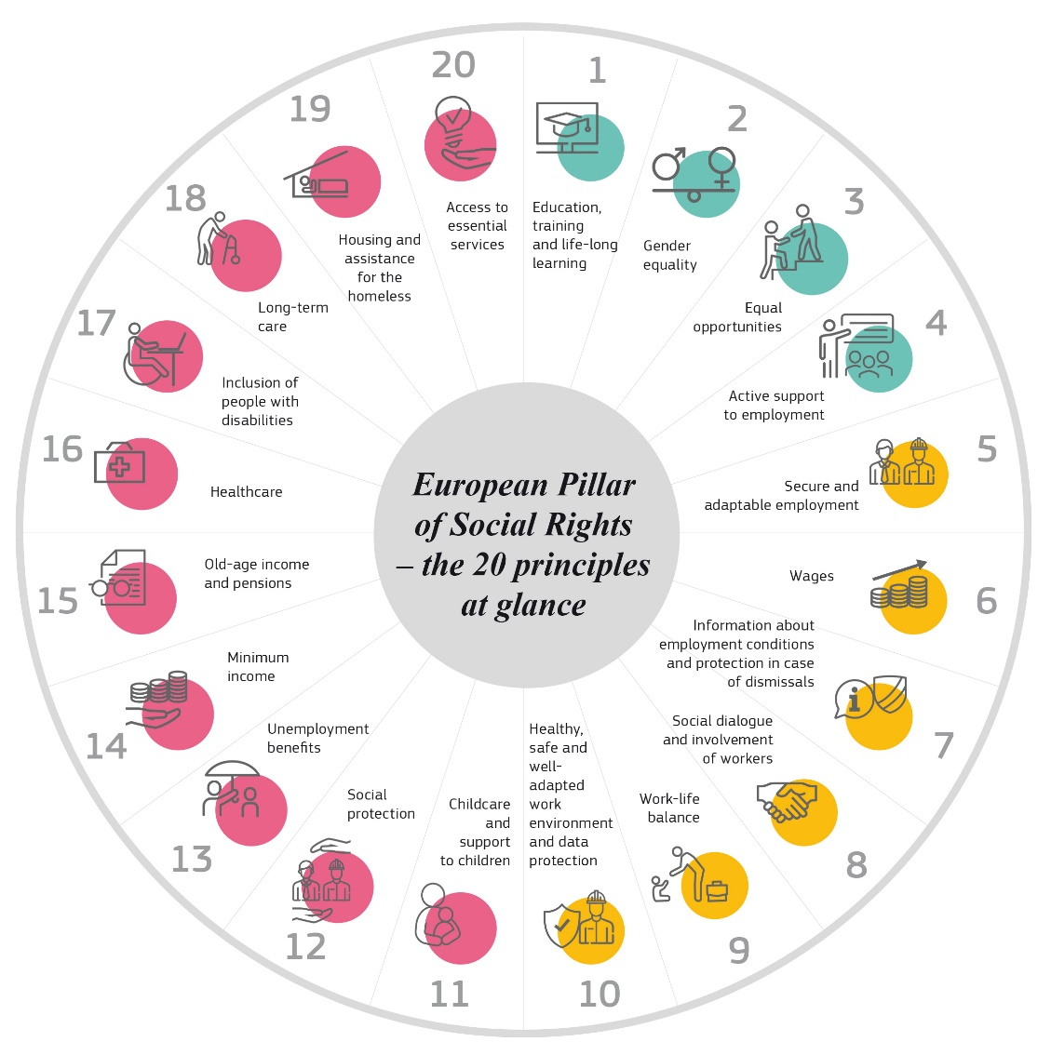
European Pillar of Social rights
Endorsed in 2017, with 20 key principles, guiding towards a strong Social Europe
EU complements actions at national level incl. Action plan adopted in March 2021
Plan to propose new Action plan by end of 2025

Slide 3
Rise in non-standard forms of work and gaps in access to social protection
Labour market statuses in EU27, 2023 (%)
New forms of employment (casual workers, platform workers, etc) have become more prevalent
Almost 40% of employment = non-standard forms of work (temporary contract, part-time) and/or self-employed
2/3 of self-employed are “solo self-employed” (19 million EU-wide)…
…among which 17% (3.3 million) worked last year for only one client (or a dominant one) and for 800.000 of them, working hours are decided by the client
Those dependent self-employed make up around 4% of all solo self-employed in the EU
Source: Eurostat, EU-LFS

Slide 4
Labour market statuses by Member State (aged 15-74), 2023 (%)
(with specific focus on the share of solo-self-employed as % of total employment)
Source: Eurostat, EU-LFS (2023), DG EMPL calculations

Slide 5
Scope/Branches:
Unemployment benefits
Sickness and healthcare benefits
Maternity and paternity benefits
Invalidity benefits
Old-age and survivor benefits
Benefits in respect of accidents at work and occupational diseases
For:
all workers &
the self-employed
Council Recommendation
on Access
to Social Protection
(adopted in
November 2019)
4 dimensions:
1. Formal Coverage
Workers:
- mandatory basis
- all branches
2. Effective coverage
Entitlements and contributions:
- rules that do not prevent access
Entitlements:
- preserved, accumulated and/ or transferable
3. Adequacy
Benefits:
- sufficient and timely
Contributions:
- proportionate
Exemptions, reductions:
- regardless of status
Self-employed:
- min. voluntary basis
4. Transparency
Schemes’ rules:
- transparent
- administrative simplification (esp. SMEs)
General and indiv. information:
- up-to-date, clear, free

Slide 6
Monitoring the implementation of the Recommendation
Recommendation adopted by the Council in Nov. 2019
A Monitoring framework with indicators covering all dimensions was developed since 2020
Member States recommended to:
implement the principles set out in this Recommendation and [to] submit a plan by May 2021
Commission reviewed the implementation of the Recommendation in a Report to the Council in January 2023

Slide 7
Implementation of the Recommendation
Analysis of the plans, consultations of stakeholders and policy exchanges
Report to the Council
Adoption by the Council
Establishment of a monitoring framework
March 2018
Nov.
2019
2019- 2020
Nov. 2020
From May 2021
2021-22
Early 2023
End 2023-2025…
Mutual learning workshops
High level event on social protection for self-employed
New mutual learning events, support to implementation,…
Proposal by the Commission
Plans informing about national measures

Slide 8
Mixed picture regarding the implementation:
Numbers of workers or self-employed people still left without sufficient access
Mixed picture regarding implementation; level of ambition varies significantly across Member States
With a few exceptions, most Member States do not aim to address all existing gaps in access
Starting point is very diverse –fewer commitments to new structural reforms in Member states with already universal/generous systems
Some ambitious reforms (focused on formal coverage) in half of the Member States…often about self-employed
…but not in a number of Member states where non-standard workers and self-employed are still not (adequately) covered

Slide 9
Many measures taken for the self-employed
Extending right to unemployment benefits: France, Malta, Ireland, Italy, Belgium (‘bridging rights’)
+ some on-going or planned (Lithuania, Estonia)
Extending rights to other branches: Cyprus (accidents at work), Italy (parental leave), Luxembourg (paternity), etc
Adaption rules for pensions (contributions): Finland, Spain, Portugal
Addressing rights for specific groups:
- Economically dependent self-employed (Italy),
-Digital Platform workers (Belgium, Italy, Spain, France),
-Artists (Spain, Italy, Portugal)

Slide 10
Formal coverage: state of play
15 Member States have formal coverage gaps for at least one group of non-standard workers in at least one branch of social protection that fall under the scope of the Recommendation.
  Branches most concerned by ‘lack of access’: unemployment, sickness, maternity benefits.
  in 13 Member States, access to at least one social protection branch is voluntary. Typical examples relate to access through opt-in systems in AT, PL, PT, RO and SK.
18 Member States have formal coverage gaps for at least one group of self-employed in one branch of social protection or more.
  Branches most concerned by ‘lack of access’ are: unemployment benefits (13), followed by benefits in respect of accidents at work and occupational diseases (10)
  Voluntary coverage for the self-employed is accessible in 18 Member States mostly through opt-in systems. The most common branches with voluntary access to social security schemes are: sickness benefits (13), old-age and survivors’ benefit (9) and maternity benefits (9).

Slide 11
Lack of formal coverage among self-employed
Size of the groups not covered across the EU (lower-bound estimates). Reference period: around 2022-23
Social protection branch | Member States without coverage | Size of the group
Unemployment benefits | BE*, BG, CY, DE*, EE, EL*, FR*, IT*, LT*, LV, NL, PL*, PT* | 15 million (based on data for 12 MS out of 13 MS with a lack of coverage)
Healthcare benefits | -
Sickness benefits | EL*, IE, IT* | 5.1 million (based on data for 3 MS out of 3 with a lack of coverage)
Maternity benefits | -
Paternity benefits | EL, MT, NL, RO | 2 million (based on data for 3 MS out of 3 with a lack of coverage)
Benefits in respect of accidents at work and occupational diseases | BE, BG, CY, CZ, IE, LT, LV, NL, RO, SK | 4.4 million (for 9 MS out of 9 with a lack of coverage)
Old-age benefits and survivors' benefits | -
Invalidity benefits | -
Note: *only one or more sub-groups of the self-employed are not formally covered. Data at national level not based on similar definitions, sources and reporting period. Source: information reported by SPC-ISG in the (2023) update of the Monitoring framework

Slide 12
Formal coverage in 2023: take-up rates
Take-up rates of voluntary schemes (2021-2023), some examples:
Categories | Branch | Take up rate
Non-standard workers | Healthcare | AT: 66.9%;
 | Old-age | AT: 27.0%; DE: 20.9%
 | Invalidity | AT: 27.0%;
 | Sickness, maternity, paternity | SK: 0%; PL: 39%
Self-employed | Unemployment | AT: 0.5%; FI*: 10-15%; SK: 1.2%
 | Old-age | DE: 10.0%; BE*: 56.8%; SK: 43.3%; ES: 90.2%
 | Sickness | BG: 60.5%; CZ: 13.4%; LT: 0%; NL: 1.4%; PL:82%
 | Maternity | BG: 60.5%; LT: 0%; SK: 43.3%; PL: 82%
 | Paternity | BG: 60.5%; PL: 82%
 | Accidents/occup. Diseases | DE: 12.6%; FI: <50%
 | Invalidity | NL : 1.4%; SK: 43.3%;
Note: * Voluntary schemes on top of mandatory. Data at national level not based on similar definitions, sources and reporting period. Source: information reported by SPC-ISG in the (2023) update of the Monitoring framework

Slide 13



EFFECTIVE COVERAGE - Receipt rate of social benefits among people at-risk-of-poverty before social transfers, employees vs self-employed (16-64), in Austria, Germany and EU-27 (%), 2023
Income support measures during COVID-19
Source: Eurostat, EU-SILC

Slide 14
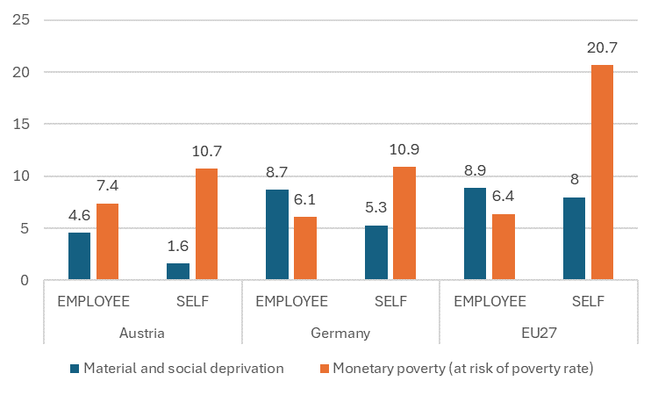
Material and social deprivation and at-risk of poverty rate (after social transfers), employees vs self-employed, in Austria, Germany and the EU-27, 2023 (in %)
Source: Eurostat, EU-SILC.

Slide 15
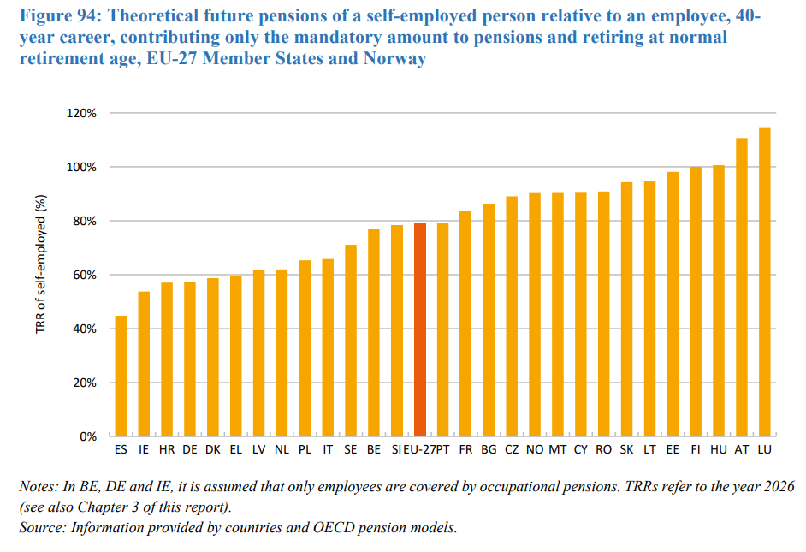
EU Pensions Adequacy Report 2024– a focus on self-employed

Slide 16
Recent policy developments at EU level
High-level event on social protection for the self-employed
(June 2022)
Council conclusions on social protection for the self-employed (under Spanish Presidency 2023)
Guidelines on collective bargaining for the self-employed
EU Directive on Platform workers
Notes:
Mutual learning event on transparency (2023), health-related benefits (2024) and monitoring of social protection (2024)

Slide 17
EU mutual learning events on acces to social protection
February 2024: mutual learning on access to healthcare, sickness benefits and accidents at work
November 2024: mutual learning on monitoring access to social protection
February 2025: mutual learning on access to social protection for vulnerable workers (including solo self-employed)
Mutual learning on social protection for artists
(6-7 May 2025)

Slide 18
Recent and forthcoming evidence on access to self-employed and on social protection
European Labour Agency report on “The extent of dependent self-employment” in the EU
Eurofound (2024) report on “Self-employment in the EU: Job quality and developments in social protection”
Eurofound (2024) report on unemployment and minimum income
(“Social protection 2.0”)
On-going research by Eurofound on digitalisation in social protection systems (2025)

Slide 19
Thank you !
Danke!
Laurent.Aujean@ec.europa.eu https://employment-social-affairs.ec.europa.eu/

Slide 20
Annex

Slide 21
Forthcoming developments in access to social protection at EU level
Update of the monitoring framework in 2025 – and further improvement
(including MISSOC)
Mutual learning on social protection for artists
(6-7 May 2025)
Opinion of the European Economic and Social Committee on social protection for self-employed (2025)
Forthcoming thematic social reporting for the 2025 (Annual report of the Social Protection Committee)

Slide 22
Forthcoming policy initiatives in the employment and social policies domain
A new Action Plan to implement the European Pillar of Social Rights (2025)
Quality Jobs Roadmap (2025)
Others (Union of Skills, Right to disconnect, Algorithmic management, etc)
Anti-poverty strategy (2026)

Slide 23
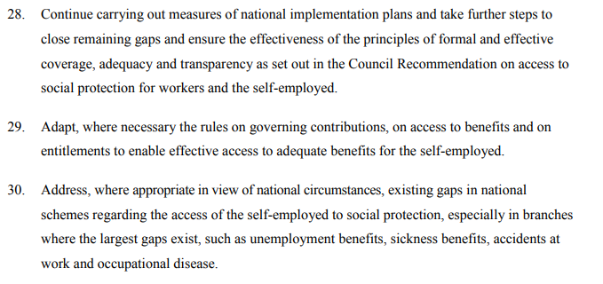
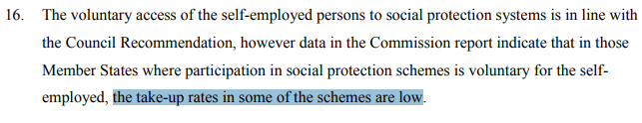

Council Conclusions on social protection for the self-employed (2023, Spanish Presidency)
Social protection for the self-employed: Council calls for action to address remaining gaps – Consilium
Some relevant extracts:
Call to Member States to :

Slide 24
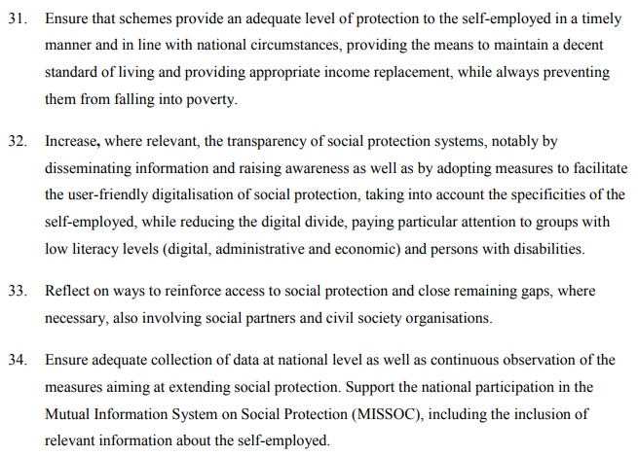
Council Conclusions on social protection for the self-employed (2023, Spanish Presidency) (2)
Call to Member States to (2):

Slide 25

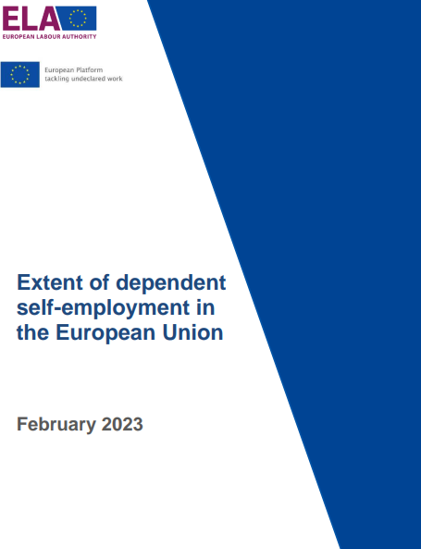
Other ressources regarding self-employed
Self-employment in the EU: Job quality and developments in social protection | Eurofound (2024)
Extent of dependent self-employment in the European Union (ELA, 2023)

Slide 26
Economically dependent solo self-employed in the EU-27 (aged 15-74, in 2023)
19.3 million solo self-employed
(= 2/3 of the self-employed
and 9.4% of tot. pop in employment)
Among which:
750,000 for which the dominant client decides working hours
(i.e. 0.4% of tot. pop in employment)
Among which: 3.3 million with only one client, or a dominant one
Source: Eurostat, EU-LFS (2023)

Slide 27
